Slide 1


People's Democratic Republic of Algeria Ministry of Higher Education and Scientific Research Mohamed El Bachir El Ibrahimi university of Bordj Bou Arréridj
Faculty of Mathematics and Computer Science
Thesis for obtaining Master’s Diploma in computer sciences
Option: Information and communication technologies
Medical analysis laboratory management system(mobile & web) based on a Microservices Architecture
-SMART LAB-
Dr. SENOUCI Oussama Senior Lecturer B at BBA University President
Dr. SAIFI Lynda Senior Lecturer B at BBA University Examiner
Dr. SAIDANI Kaouther Senior Lecturer B at BBA University Reporter
Academic Year : 2022/2023
Notes:
A: (Page 1 & 2) Al Salam alaykoum, and welcome in today's presentation of our final study project everyone who is present today from our families and friends and the judges of today welcome again... We're happy to say that we finished that project, under the title of (" Medical analysis laboratory management system based on a Microservices architecture "), with mobile and web solutions, to obtain the Master's degree in the academic year 2022-2023.

Slide 2

Presented by
- Anis SAOUDI
- Nour El Islam ATTIA
Supervised by
- Dr. Kaouther SAIDANI
2
Notes:
A: presented by me SAOUDI Anis and my colleague ATTIA Nour Al Islam.

Slide 3
Table of contents
01
02
03
Introduction
Existing models
Modelization
04
05
Implementation
Conclusion and perspectives
3
Notes:
A: (Page 3) Okay.., we will start our presentation with the table of contents, of course, we will begin with an introduction, Next we will see some of the existing models and there features, then we will jump into our project modelization.
Then we have the implemtation part Finally, we will stamp it with conclusion and perspectives.

Slide 4
Table of contents
01
02
03
Introduction
Existing models
Modelization
04
05
Implementation
Conclusion and perspectives
4
Notes:
Islam: we will begin with an introduction

Slide 5
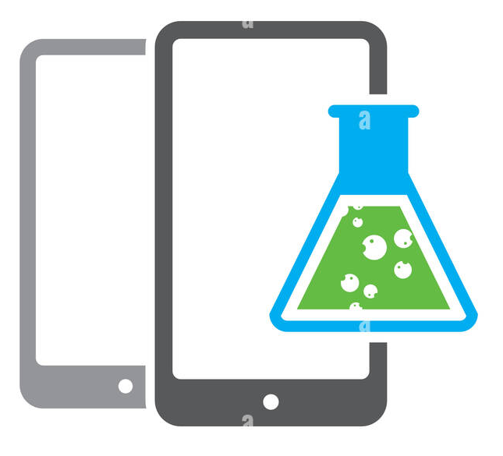




Context
Management of medical analysis laboratories /
Mobile or web application
Effective management of medical analysis operations.
Good management of invoices and payments.
Computerization of communication.
Possibility of remote control and management.
Easy user access to their medical information.
View test results remotely.
5
Notes:
I: (Page 4) Medical analysis laboratories play an essential role in our environment by contributing to public health, Smartphones or tablets have become a main everyday object for managers and employees of medical analysis laboratories. Mobile/web applications have already secured their place in the management of medical analysis laboratories through: - Effective management of medical analysis operations... And - Good management of invoices and payments... also - Easy to access their medical information, and View test results remotely.

Slide 6


Problematic
A
Between the laboratory and the subcontractor:
Lack of effective communication and close coordination.
Lack of follow-up.
Time consuming.
B
C
Which leads to :
Delays in receiving results.
Loss of blood tubes.
Sample transmission errors.
D
Subcontracting problem
6
Ce qui Entraine :
Retards dans la réception des résultats
Pertes de tubes de sang
Erreurs de transmission des échantillons.
Entre le laboratoire et le sous-traitant :
Manque du suivi.
Absence d’une communication efficace
et d’une coordination étroite.
Notes:
I: (Page 6) In our current situation, we discovered that there is a Lack of effective communication and close coordination between laboratories, as well as a Lack of follow-up with their packages and tubes and that is a big problem that consumes time. Which leads to Delays in receiving results, and sometimes loss of blood tubes or sample transmission errors.

Slide 7
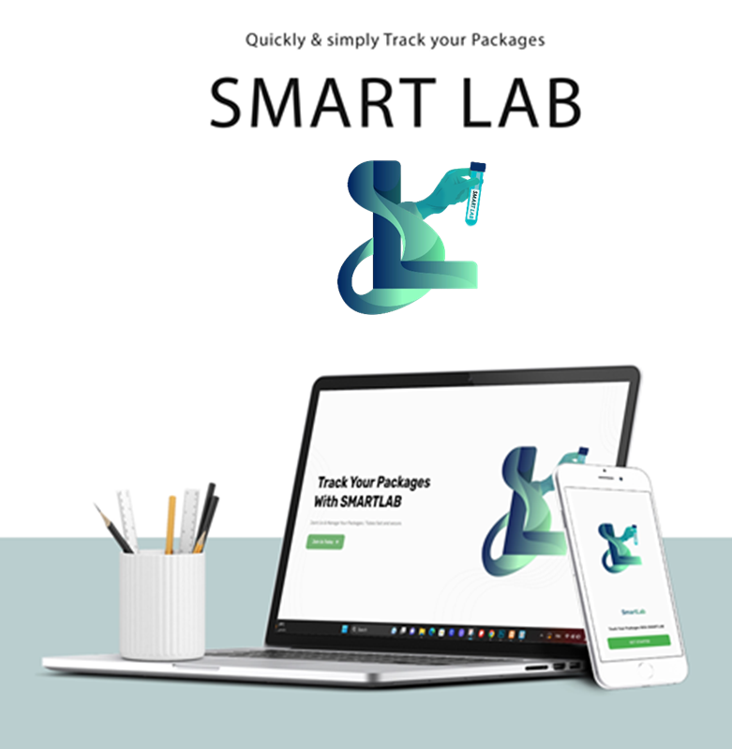
Objectifs and contribution
Realize a mobile & web application based on a microservices architecture.
Manage tasks simply, conveniently and reliably anytime, anywhere with ease and confidence.
Facilitate collaboration between laboratories.
Ensure proper monitoring of subcontracting.
Manage data effectively.
Guarantee data security.
Improve work efficiency and Increase productivity.
Optimize certain processes.
7
Notes:
A: ( Page 7 ) Depending on those problems, We state our objectives, from Realize a mobile & web application based on microservices architecture, and first is: - Simply manage the laboratory tasks, anytime anywhere. - Facilitate collaboration between laboratories... as well as - Guarantee data security. - improve and Increase productivity.

Slide 8

Why Microservices architecture ?
8
Notes:
A. ( Page 7 ) To provide the services we decided to realise, we choose the microservices architecture, so why this type of architecture..?

Slide 9


Monolithic architecture
Microservices architecture
9
Notes:
A. ( Page 9 ) because in general we have two type of architecture... First the Monolithic architecture... along with The Microservices architecture And what is the difference between those two?

Slide 10
Monolithic architecture
Monolithic architecture is a traditional style of software architecture in which all components of an application are combined into a single, tightly coupled unit.
Benefits
Challenges
Easy deployment and development.
Reduced complexity.
Improved performance.
Difficulty of maintenance.
Limited scalability and Flexibility.
Risk of a single point of failure.
10
Notes:
Islam (Page 10) Monolithic architecture is a traditional style of software architecture in which all components of an application are combined. it has some benefits like easy deployment and development, and reduce complexity, but it also has some Challenges from difficulty of maintenance and limited scalability and flexibility to Risk of a single point of failure.

Slide 11
Microservices architecture
The microservices architectural style is an approach to developing a single application in the form of a software suite integrating several services.
These services are built around enterprise capabilities and can be deployed independently.
Benefits
Challenges
Improved scalability.
Technological flexibility.
Reduction of breakdowns.
Security.
Services communication.
11
Notes:
Islam: (Page 11) On the other side, we have the microservices architecture which allows a large application to be separated into smaller independent parts, with each part having its own realm of responsibility. Also, this type of architecture has some benefits from improved scalability and technological flexibility because we can use many different languages and databases in one project, and Reduction of breakdowns. moving to challenges of security and the communication between services.

Slide 12
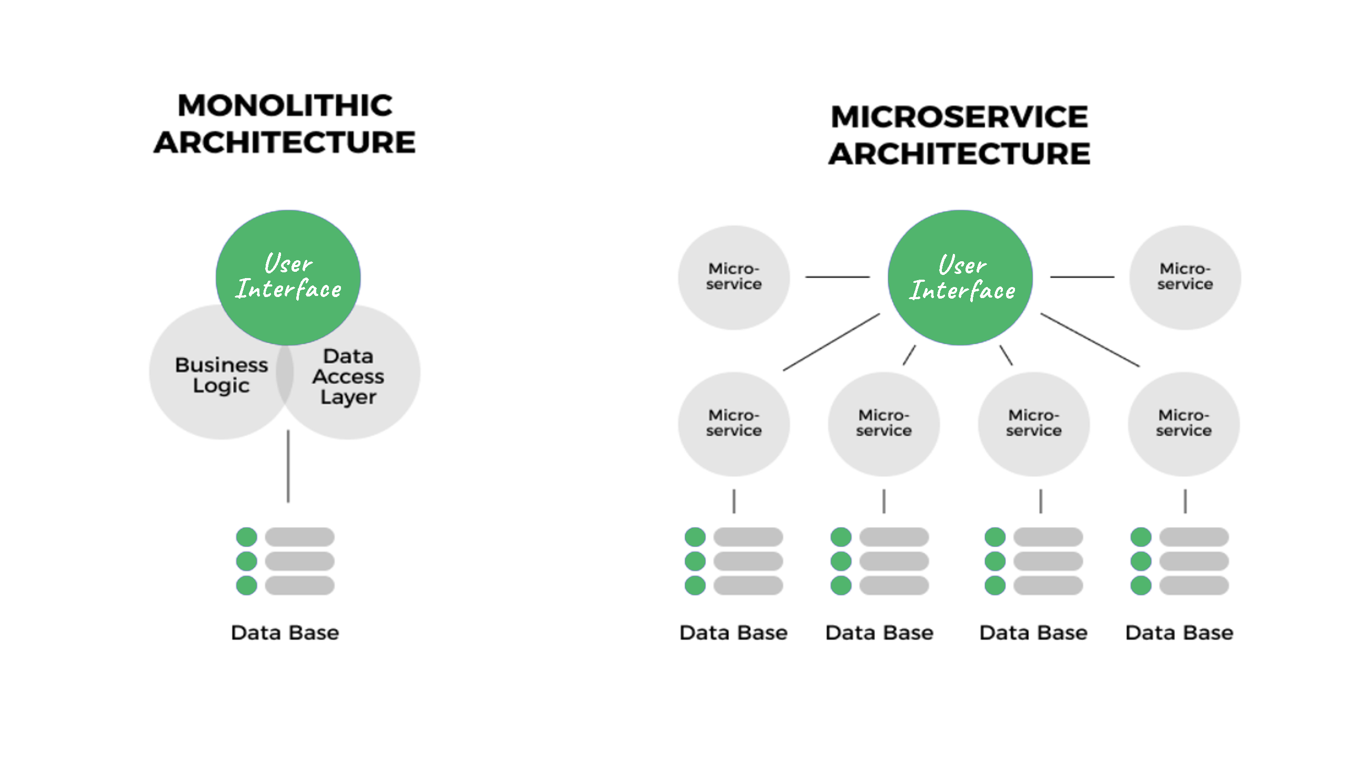
VS
12
Notes:
A. (Page 12) When we put those architectures next to each other, we can note that the project that is based on a monolithic architecture is one service combined in one server and owns only one database. On the other side, the microservices architecture is separated into smaller parts each one of them works independently and every part of them can have its own database or a shared one.

Slide 13
Table of contents
01
02
03
Introduction
Existing models
Modelization
04
05
Implementation
Conclusion and perspectives
13
Notes:
islam:(Page 12) Next, we will take a quick look at some of the existing models that we found.

Slide 14
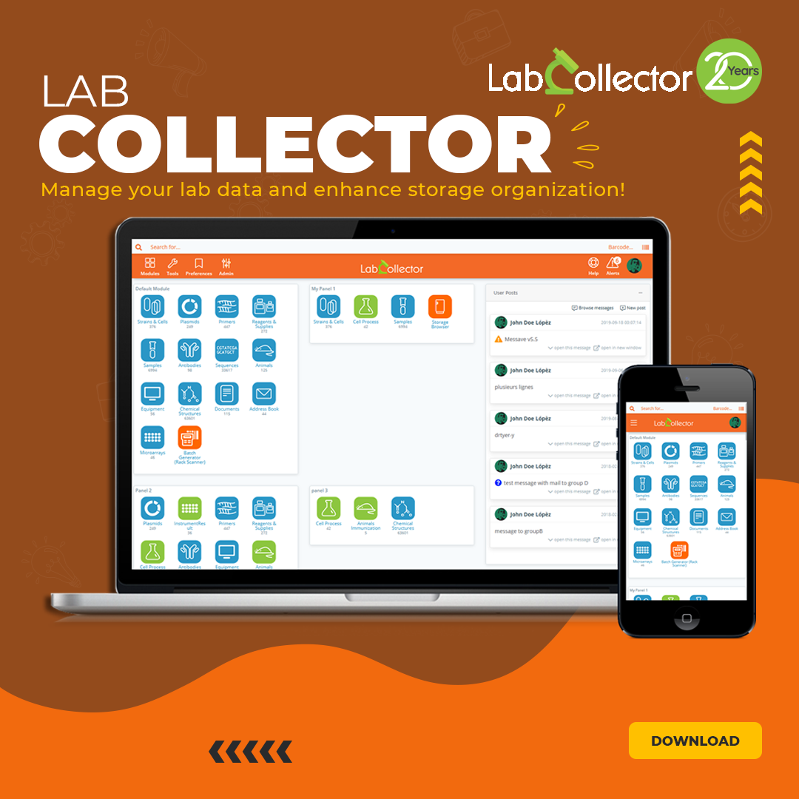
LabCollector
Features :
Creation of test protocols.
Final report and invoice generator.
Assistance in connecting to PCR machines.
14
Notes:
Islam. (Page 13) First, LabCollector... provide desktop and mobile applications to manage lab data and store those data and they are distinguished at the Creation of test protocols and report and invoice generator help to Assist in connecting to PCR machines.

Slide 15
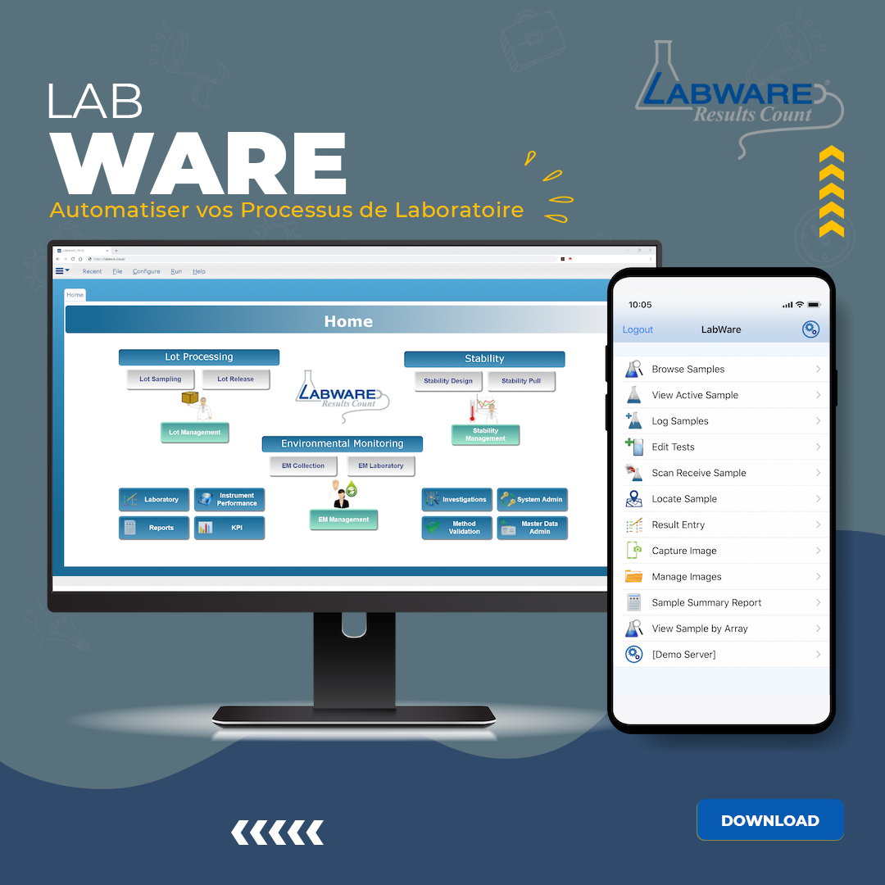
LabWare
Features :
Patient management.
Creating and uploading files and photos.
Registration of samples.
15
Notes:
Islam. (Page 15) Second, we have LABWARE which also provides desktop and mobile applications, that are featured by Patient management in a clinical laboratory,... Creating and uploading files and photos, and finally Registration of samples.

Slide 16
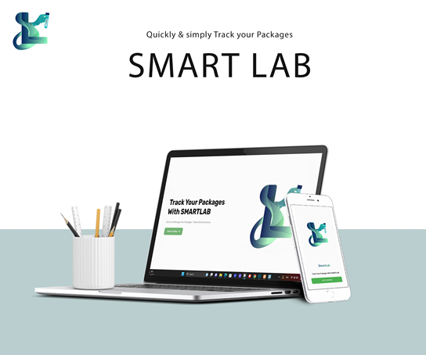
Proposed model description
16
Notes:
A. (Page 15) More importantly, now let's take the case and talk about our proposed model description:...

Slide 17
Among the features of our proposed application:
Define which labs can receive packages based on the analysis type.
View transaction history of blood tubes and packages.
Add blood tube information.
View and verify results anytime, anywhere.
Track package status.
Send results in PDF form.
17
Notes:
A.(Page 17) And I want to begin with the main features of our proposed application:... - First the creation of blood tube information, and defining which labs can receive packets based on the type of analysis ...then - Track package status from origination into the received... also - Sends results in PDF form... and - Manage the delivery men's accounts.

Slide 18
Proposed model objectives
Good management of the load of received packages (cases of an epidemic, for example the case of COVID-19).
Develop an application, clean and simple to use.
Have quick access to package samples and analysis results.
Ensure the highest level of monitoring of subcontracting (Packages, Blood tubes), and good communication and interaction between laboratories.
Manage data efficiently and securely.
18
Notes:
A. (Page 18) And proposed model objectives are:... - Good management of a load of packages especially in cases of epidemic like COVID-19. - Develop, a simple use and clean application... and - Quick access to package samples and analysis results - Manage data efficiently and securely

Slide 19
Table of contents
01
02
03
Introduction
Existing models
Modelization
04
05
Implementation
Conclusion and perspectives
19
Notes:
Islam. (Page 18) Thirdly in our table of contents is the modelization of the project:

Slide 20
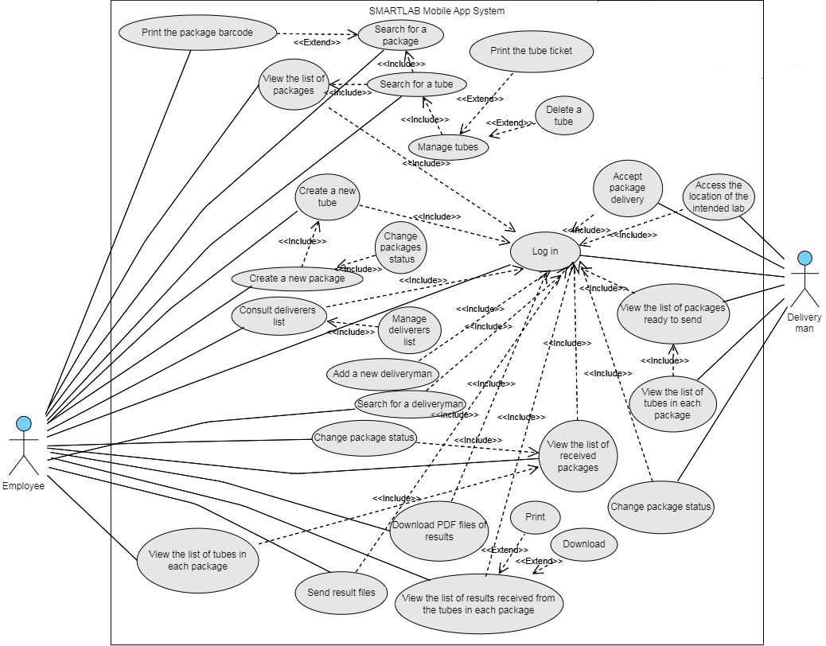
Use case diagram for mobile app
20

Slide 21
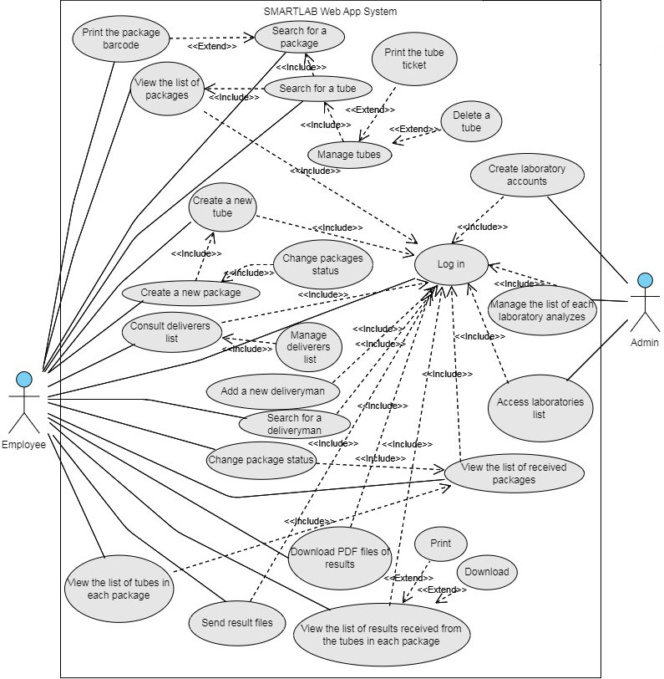
Use case diagram for web app
21

Slide 22
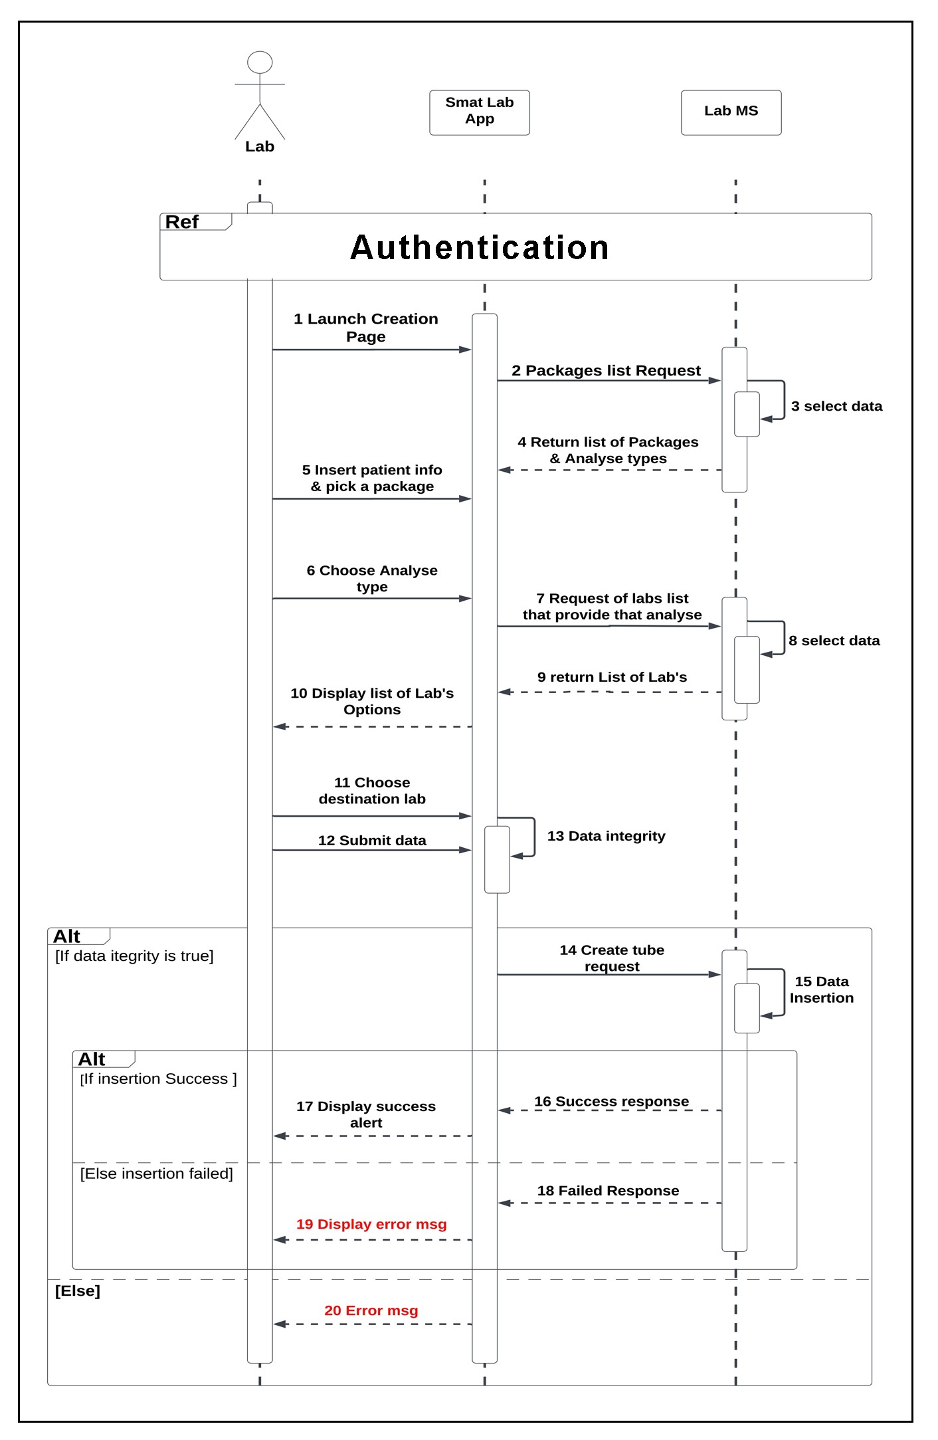
Sequence diagram : “Create a new tube of blood”
22

Slide 23
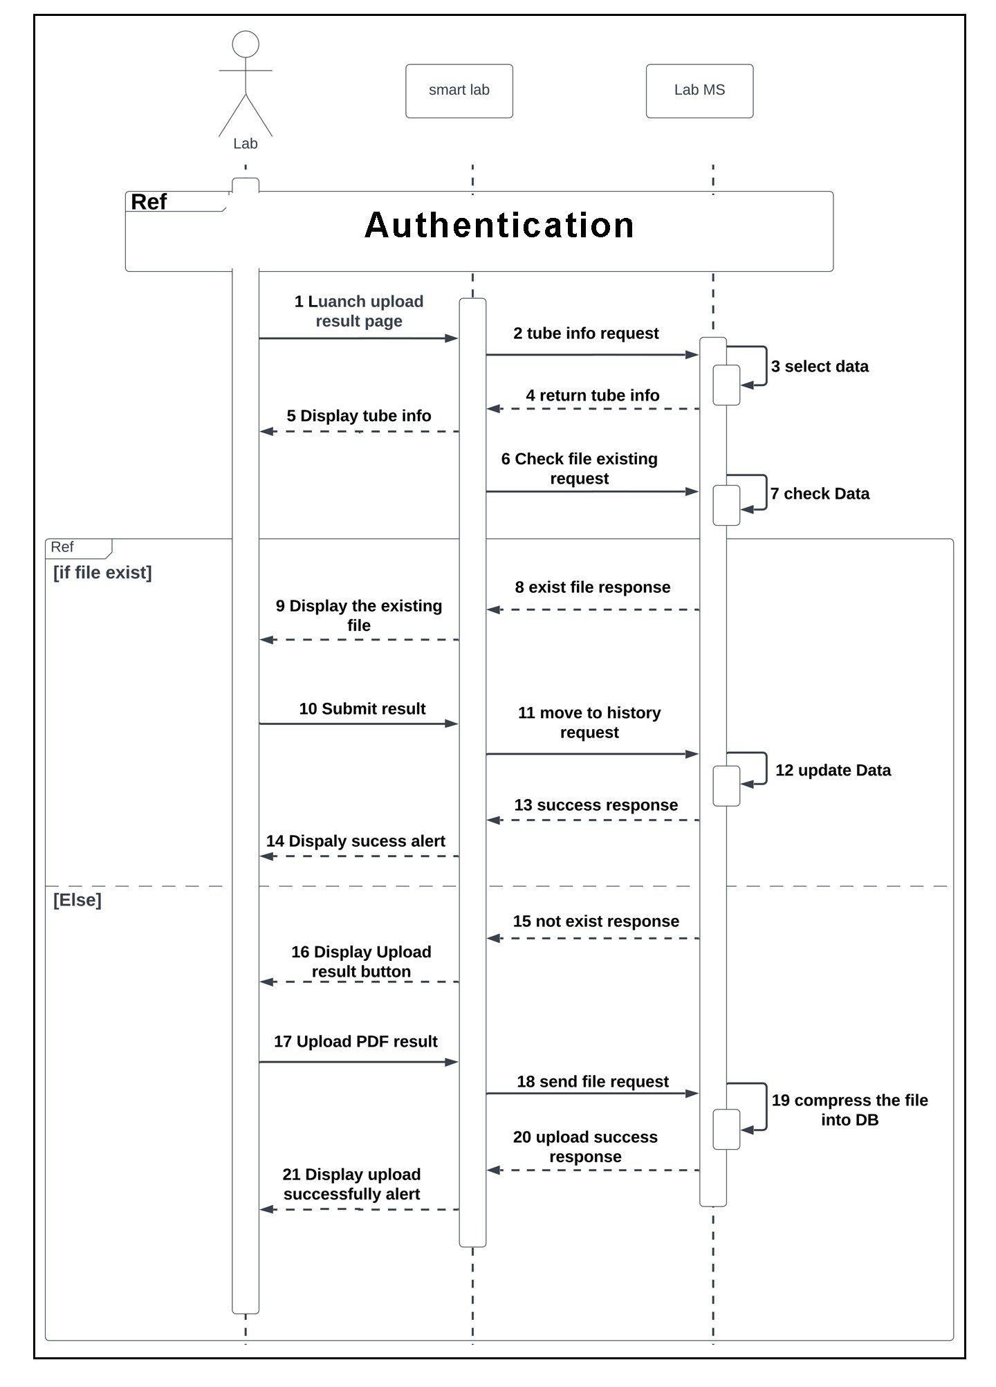
Sequence diagram : “Download result”
23

Slide 24
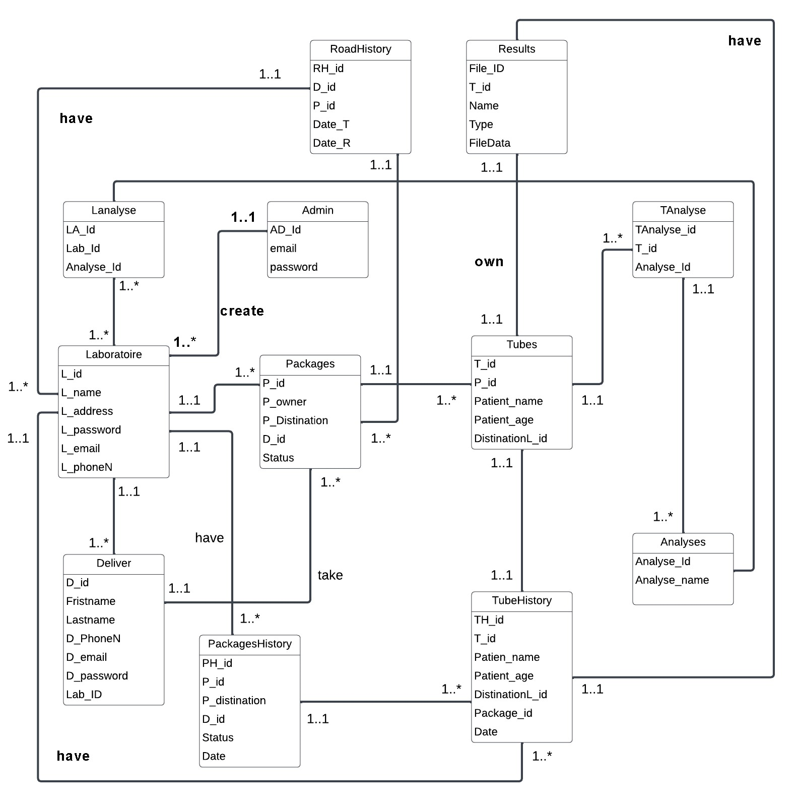
Class diagram of “SMARTLAB”
24

Slide 25
Table of contents
01
02
03
Introduction
Existing models
Modelization
04
05
Implementation
Conclusion and perspectives
25

Slide 26












Software environment
Web | Mobile | Backend | DB
HTML | Flutter | Spring boot | MongoDB
Bootstrap | Dart | Keycloak | Postgresql
CSS |  | JAVA
jquery |  | Docker
26

Slide 27
“SMARTLAB” architecture
27

Slide 28
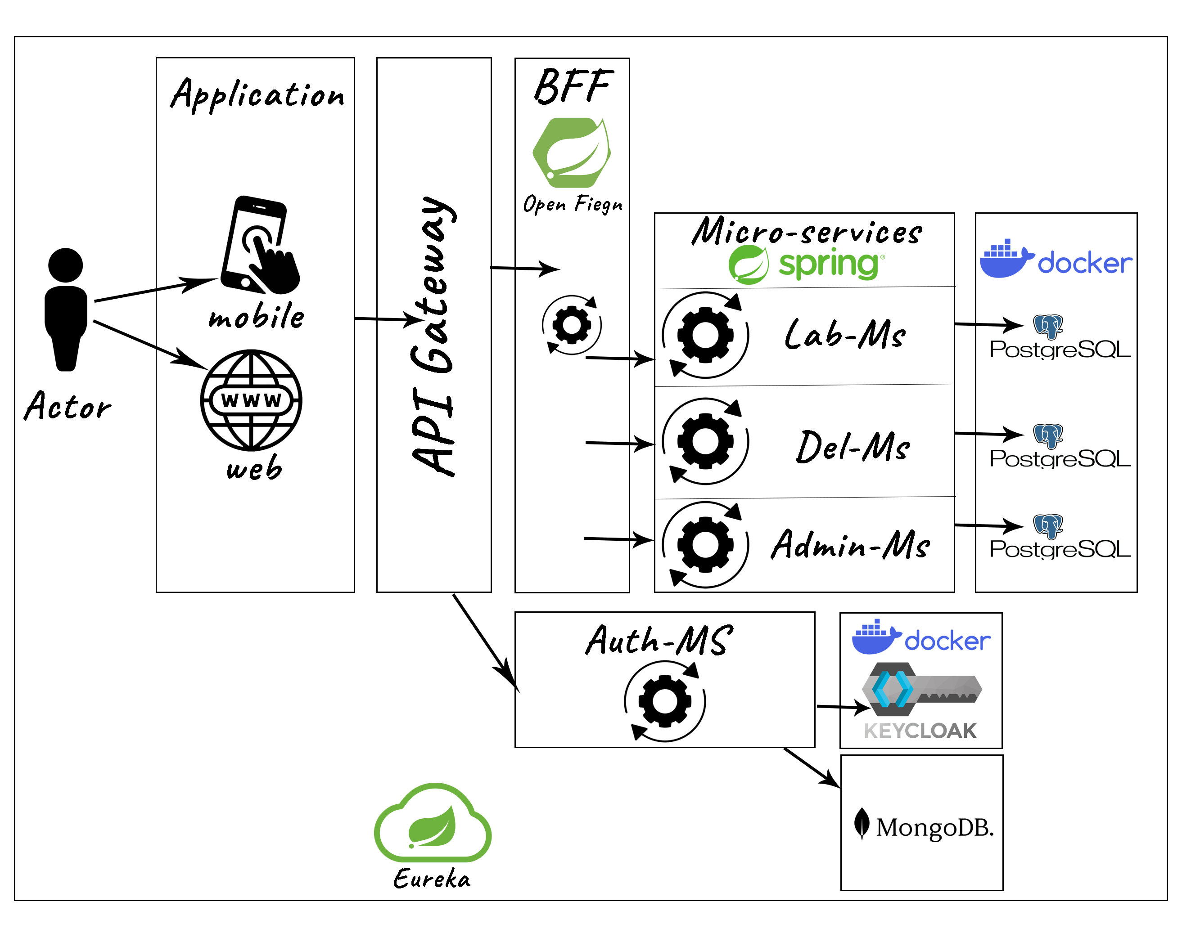
“SMARTLAB” architecture
28

Slide 29
Video Presentation
29

Slide 30
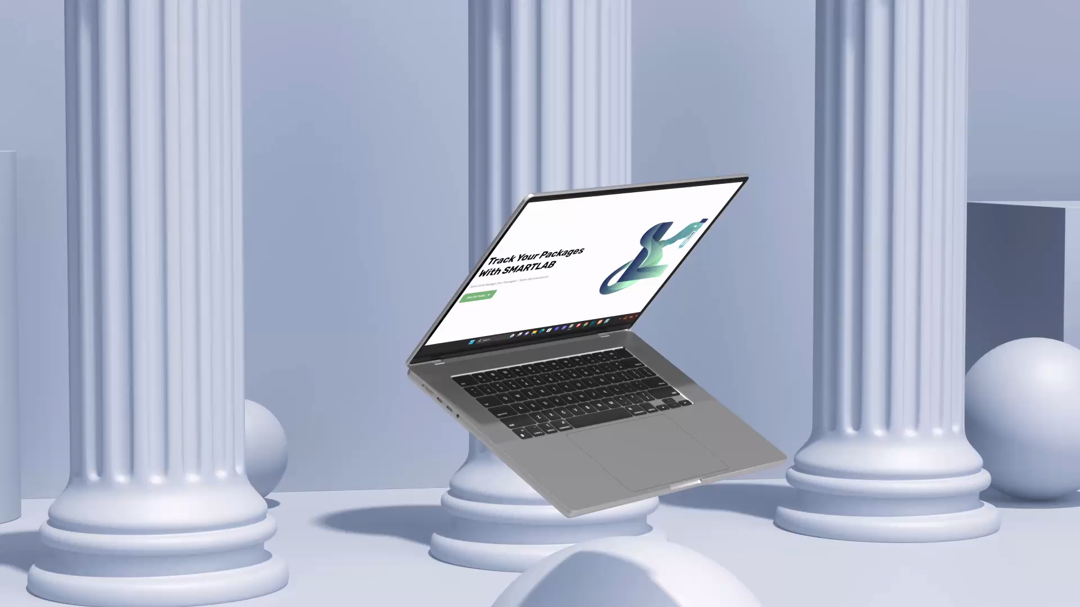
30

Slide 31
Table of contents
01
02
03
Introduction
Existing models
Modelization
04
05
Implementation
Conclusion and perspectives
31

Slide 32
Conclusion
In this work, we developed a mobile & web application, named 'SMARTLAB', based on a Microservices Architecture, which handle the subcontracting problems in laboratories of medical analysis.
This application is capable of guaranteeing good communication and interaction between different laboratories and between managers and employees. Besides, it can be used anytime, anywhere with ease and confidence.
This project has been very beneficial to us, because we have enriched our knowledge on both levels: theoretical and practical. It also allowed us to discover and acquire new knowledge in mobile & web development, and also to explore new concepts such as microservices architecture, cloud, containerization, etc.
31

Slide 33
Perspectives
The addition of GPS location with the option to follow the delivery person in real time.
The introduction of artificial intelligence when choosing laboratories according to the types of analysis (the closest, speed of results, etc.).
The addition of messaging for better communication between teams.
Adding financial management between laboratories by adding the option of invoicing, where each laboratory can see its own invoices.
The addition of the option “add several types of medical analysis on the same analysis tube”.
32
Ce qui Entraine :
Retards dans la réception des résultats
Pertes de tubes de sang
Erreurs de transmission des échantillons.
Entre le laboratoire et le sous-traitant :
Manque du suivi.
Absence d’une communication efficace
et d’une coordination étroite.
Notes:
Ces laboratoires font très souvent appel à des laboratoires sous-traitants pour diverses raisons. Dans ce cas, le problème de sous traitance expose. Il réside dans le manque du suivi et l’absence d’une communication efficace et d’une coordination étroite entre le laboratoire d’analyses médicales et le sous-traitant, ce qui peut entrainer des retards dans la réception des résultats d’analyses, des pertes de tubes de sang ou même des erreurs de transmission des échantillons.
These laboratories very often use subcontracted laboratories for various reasons. In this case, the outsourcing problem exposes. It lies in the lack of monitoring and the absence of effective communication and close coordination between the medical analysis laboratory and the subcontractor, which can lead to delays in receiving analysis results, blood tube losses or even sample transmission errors.
Medical analysis laboratories often outsource to subcontracting laboratories for a variety of reasons. However, this can lead to problems if there is not adequate follow-up, communication, and coordination between the two parties. This can result in delays in receiving test results, lost blood samples, or even errors in transmitting samples.

Slide 34
Thank you

